Slide 1
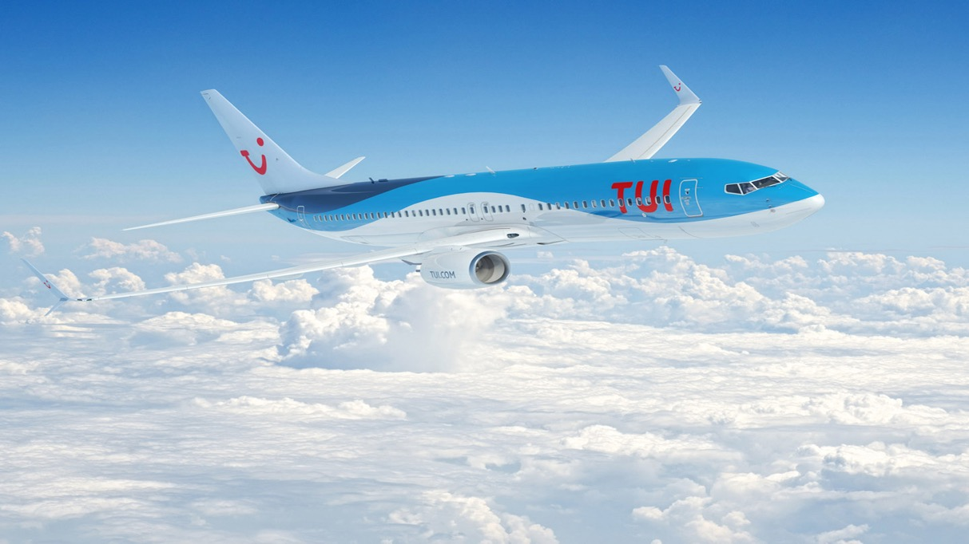
How to DevOps the hell out of your COVID Crisis
Pieter Jordaan – Group CTO – TUI Group

Slide 2
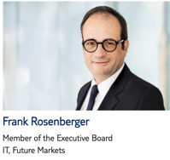
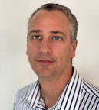


Pieter Jordaan – TUI Group CTO
Group Who am I?
Linkedin/in/jordaanpieter
Pieter.Jordaan@tui.com

Slide 3

Journey of €20 Billion Group to all-in Cloud, DevOps and Product Organisation during COVID Crisis
How did we start?
How did we go from small local initiatives in 15 countries to Global, all-in transformation
How COVID accelerated our journey and the discoveries we made
The textbook rules we broke to achieve our goals

Slide 4



The world’s number one integrated travel company
More than 27 million customers travelling with us per year.
150+ TUI Aircrafts
380 Hotels
20 Data Centers
400 million
Product combination
€19.5 bn
Turnover
16 Cruise ships
8 million
price updates / hour
58 billion
Searches / peak period
115 destinations
1,600 travel shops in Europe
*Pre COVID numbers
4
Notes:
Who is TUI?
TUI is a world leading travel business with €19.5 bn turnover
You visit our website or shop, fly on our plane, sail on our ship, stay at our hotel and experience our destination excursions.
We take 27m passengers on holiday to 115 destinations
We have over 400 million product combinations on sales with over 8 million price updates / hour.

Slide 5



Our Transformation Journey
Localized Agile
Local agile teams
Global Programs / Projects
Focus on Risk Management
Global Transformation
Consolidate NOW !
Project to Product
1 Platform
Digitalise processes
COVID – Heart Attack
Revenue grind to halt
Traditional Cloud Migration Approach
Small Workloads
Focus on Data center migration
During COVID we achieved in months what would have taken years

Slide 6

Our Transformation Goals was similar to most companies
Global Product Organisation powered by single Digital Platform
Consolidate IT & Business capabilities but serving local markets
Single IT platform based on Cloud, DevOps and Flow
Our timeline was LIMITED

Slide 7
First Migration - € 5.8 billion Selling Platform in 6 Months
130 staff trained
379 EC2 instances
3 Availability zones
39 Load balancers
7 Brands
~70% re-usable code
27 Environments
~230K lines of code
1 second billing
95 Security groups
From 97% to ~99.99 % Infrastructure availability
Migrated a business critical system first

Slide 8

Leadership Transformation Requirements
Wide - all ITIL capabilities
General management by KPI
(Revenue /Cost, Resources, Uptime)
Manage risk (avoid failure)
Deep - own single domain i.e Sales
Technology leadership & transformation
(Cloud, DevOps, and Flow Maturity)
Manage creative process (fail fast)
Leadership buy-in is the single biggest accelerator in your transformation
© TUI Group 2019

Slide 9

Success Factors and Patterns
Leadership – Deep Technical Leaders vs Wide General Management
Cloud is oxygen – Cloud migration strategy must match transformation‘s size
Business Migration follow IT Consolidation – Business is organised aournd IT systems
Shift to Product & Cloud at the same time
Product → Agile
Cloud → DevOps
Change your view of ‘Risk‘ – Manage Creative process instead of managing Risk
Day 1 mentality
Don‘t solve a problem you are not yet facing. Move fast.
Global Increments and Demo Days.
Avoid 1 way door decisions (stay flexible)
Focus on Visibility – Flow & Business Value

Slide 10
Our TUI Transformation Rules
Move fast, Move in increments
A capability exist once
Everyone will go to AWS
Use the highest level availible service
Dont build something the already exist
Serverless, Step-function first
Avoid 1-way door decisions
Invest ones, use multiple times – Central vs. Localised
Consolidated large business values first – minimise delayed benefits
Break the univers into smaller parts – nothing bigger than 1 increment (6 weeks)

Slide 11
Textbook Rules we broke
"Start with small workload to migrate to the cloud“ – We started with most critical workload
„Lift and shift workloads to Cloud“ – We rebuild net-new and retire legacy. Focus on rebuild of 5R.
“Proof concept of agile initiatives then scale“ – We transform Globally to Agile and Product.
Be brave and start the journey

Slide 12

What are we doing now and how can you help?

Slide 13
Thank You
Linkedin/in/jordaanpieter
Pieter.Jordaan@tui.com

